Slide 1
Mental Health Strategies for Reducing Stress in the Workplace
Building Resilient Communities Conference – November 18-21, 2024

Slide 2
Setting Expectations
Mutual Respect
Confidentiality
Safety
Participation
Notes:
Unconditional Positive Regard
What is shared in here stays in here
Trust
Willingness to be vulnerable

Slide 3
Learning Outcomes
How stress impacts our brain, body and emotions
Identify strategies for Reducing Stress
Learn Stress Reduction Techniques
Experience Stress Reduction Techniques

Slide 4
Stress Response
Fight – remove or destroy the threat
Flight – run away from the threat
Freeze – play dead and hope the threat goes away
Fawn – try to please or distract the threat to reduce it
Notes:
Physically active responses can sometimes help us to dissipate the stress
Physically passive responses can sometimes prolong the stress response
Animals in nature will often have extreme shaking and tremors in response to threat and this mechanism releases the stress and allows the animal to calm down and continue with life.

Slide 5
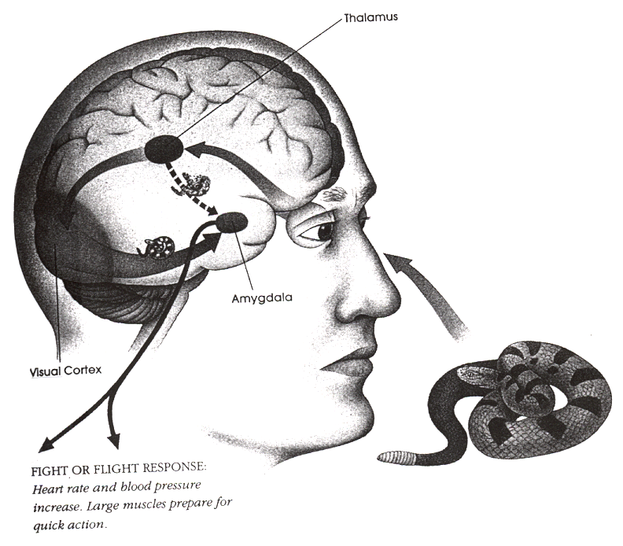
Physiological Processes
Perceived threat (real or imagined)
Learned response (ages 0-6)
Increased levels of adrenaline (short burst and cortisol (long-term)
Notes:
Hormones kick in and provide us with extra strength etc. to deal with threats.
0-6 – no ability to logically think things through, just accept whatever comes our way as truth.
Form beliefs around whether the world is a safe place or a dangerous one.
Brain doesn’t know the difference between real and imagined.
Higher levels of cortisol become normal and our bodies don’t know how to relax

Slide 6
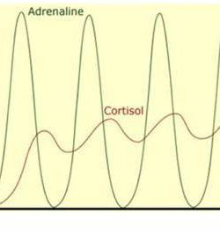
Physiological Processes
Same elements create cortisol and human growth hormone (HGH)
Cortisol up, HGH down
Less HGH reduces the body’s ability to heal and fight disease
Notes:
Can only make one of these at a time
What do you believe? Is this a safe world or a dangerous one?
Gene expression – stress turns on unhealthy gene expression while calm peace turns on healthy gene expression (1 hour of EFT proven to change up to 72 gene expressions in the DNA towards health)!

Slide 7
Psychological Processing
Situation
Response
Story
Belief
Repeat Pattern
Our Truth
Notes:
Do you ever find yourself overreacting to a situation or something someone says?
Something bad happens (real or imagined).
Activate stress response (fight, flight, freeze or fawn).
Create a story to give this situation meaning.
Develop core beliefs about ourselves to make sense of this situation.
Develop coping mechanisms to deal with our new “reality”.
Base our lives on a core belief we often don’t even know is there.
Repeat patterns to keep this “truth” alive (what we look for we will find!)

Slide 8
What turns stress into trauma?
When the threat is:
Unexpected / violates our expectations or boundaries
Threatens our existence
Alone (no help in sight)
Powerlessness (no ability to get away or protect ourselves)
Notes:
Any one of these or a combination can result in trauma.
What happens next is the key to whether this trauma gets resolved or festers!
This is why people can experience the exact same thing and respond so very differently!
If not, share example of Emergency First Aid taught by Bil Austin (BCAS) as a way to prepare us for potential “failure” when providing CPR.

Slide 9
Ways to Mitigate Stress
Exercise
Meditation
Spiritual Practices
Emotional Freedom Techniques
Debriefing
Regular Sleep
Notes:
When we start ruminating, try saying: “The Story I am telling myself right now is …” Brené Brown

Slide 10
Creating Balance in Stress-filled Lives
Quiet space
Ceremonies
Connections
Grounding
Reaching out
Notes:
ESS – quiet space for volunteers

Slide 11
Body – Mind Connection
Body, mind, soul & spirit are interconnected
EFT creates a safe space for re-connecting these parts and healing more fully

Slide 12
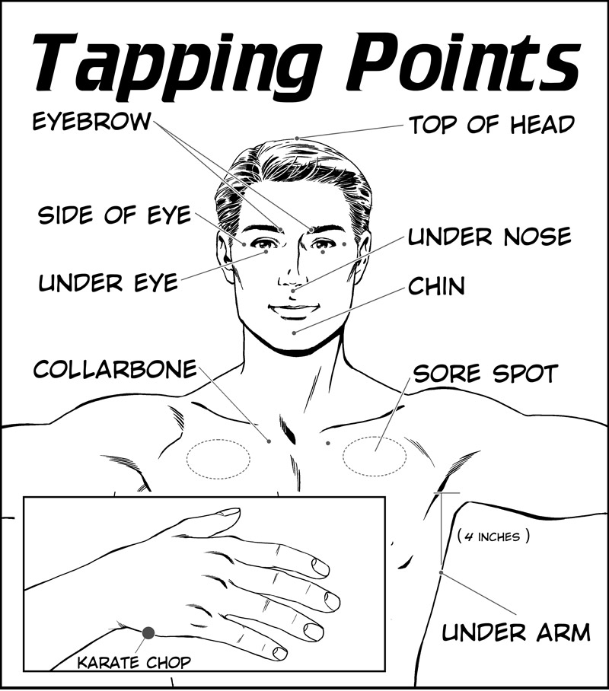
Emotional Freedom Techniques (aka Tapping)
Notes:
Take everyone through a round of Basic Recipe explaining the process and rationale.
Meridians: How energy flows through our nervous system
Karate Chop: Small intestine - Releases feeling stuck and promotes ease in moving forward, letting go, healing from grief, and becoming happy in the present moment.
Head: Spirit – Releases trauma in our thinking and promotes our spiritual connection.
Eyebrow: Bladder - Releases trauma, hurt, and sadness and promotes peace and emotional healing.
Side of Eye: Gallbladder - Releases resentment and anger and promotes clarity and compassion.
Under Eye: Stomach - Releases fear and anxiety and promotes feelings of contentment, calmness, and safety.
Under Nose: whole body function - Releases shame and powerlessness and promotes self-acceptance, self-empowerment, and compassion for self and others.
Under Mouth: Brain function - Releases confusion and uncertainty and promotes clarity, certainty, confidence, and self-acceptance.
Collarbone: Kidney - Releases the feeling of being stuck, promotes ease in moving forward, and boosts confidence and clarity.
Under Arm: Spleen - Releases guilt, worry, and obsessing and promotes clarity, confidence, relaxation, and compassion for self and others.

Slide 13
Typical Tapping Sequence
Tap and express what is bothering you
Gauge emotions/body sensations (0-10 or low-medium-high)
Setup Statement “Even though … I accept/I choose/I am safe …”
Tap through points 3+ times using your own words
Check in on how strong your emotions/body sensations are now
Repeat as necessary working on different aspects of the event
Notes:
Round 2 of Basic Recipe
Explain aspects (see, hear, touch, smell, taste, emotions and thoughts)

Slide 14
Grounding Techniques
54321 (See, Touch, Hear, Smell & Taste)
Breathing exercises
Compassion hold
Connecting heaven & earth
Heart coherence
Waking up the Chi
Notes:
Practice a couple of these with everyone.

Slide 15
Scenario
What is my body response?
How strong do I feel this response (0-10)?
What is the story I am telling myself?
Stress-Reducing Strategies:
Massage cuticles
Compassion hold
Tapping
Notes:
Boss calls you into the office and closes the door behind you. OR
It’s been a long day in the EOC. It is Day 4 and your team is just beginning to settle in. You know that everyone is tired and frustrated. You just reviewed your shift with your replacement and are heading home. Thoughts of your community and the long recovery road ahead are swirling in your mind. How can you even begin to relax so you can get some much-needed rest?

Slide 16
Returning Yourself to Safety
Tap in new understandings
Acknowledge unfinished processes
Sneak away by “Boxing” (putting event away until you are ready to deal with it again)
Notes:
Practice these techniques

Slide 17
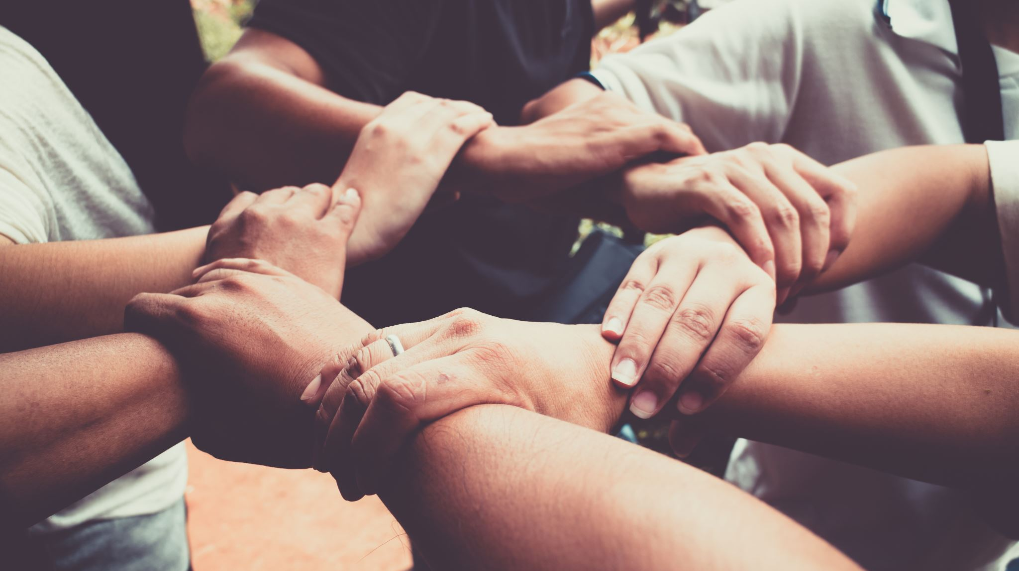
Take care of yourself so you can help others.
Notes:
EFT tapping is one of the ways you can take care of yourself when situations arise in your own life.
Set the example by asking for help when you need it too.

Slide 18
Q & A
Sybille Sanderson
Sybille@sybillesanderson.ca
1-236-594-7237

